Slide 1

Time Series Forecasting Platform
(Brent Crude Oil)
Akil Mohamed Firos
Student id - 219015127
MSc AI for Business Intelligence
Academic Supervisor - Andrew Morozov
Multi-Model Benchmarking, Historical Stress Testing & Decision Platform

Slide 2
Table of Contents
Project Overview & Data Pipeline
Baseline Failure & The Machine Learning Leap
Out-of-Sample Model Benchmarking
Out-of-Time Historical Regime Testing
Champion Selection & Failure Analysis
Limitations & Future Architectural Scope

Slide 3
Project Overview & Data Pipeline
TARGET (Yt)
Brent Crude Spot
• Weekly Friday Close
• Period: 2016 – 2026
• Yahoo Finance API
CURRENCY (X1)
US Dollar Index (DXY)
• Oil is USD-denominated
• Currency mover
• Yahoo Finance API
SENTIMENT (X2)
VIX Volatility Index
• Global fear / panic proxy
• Sell-off indicator
• Yahoo Finance API
SUPPLY & SPREAD (X3, X4)
OPEC+ & WTI Crude
• Cartel production quotas
• Brent-WTI arbitrage
• EIA & Yahoo Finance
PREPROCESSING & FEATURE PIPELINE | DATA SPLIT SCHEME
Resample: Synchronized to uniform weekly Friday Closes | 80% Train / 20% Out-of-Sample
Lag Matrix: Engineered t-1, t-2, t-3 windowing for memory | Strict Chronological Order
Normalization: Log-scale target (Brent_Log) & Z-scores | No Lookahead Bias / Data Leakage

Slide 4
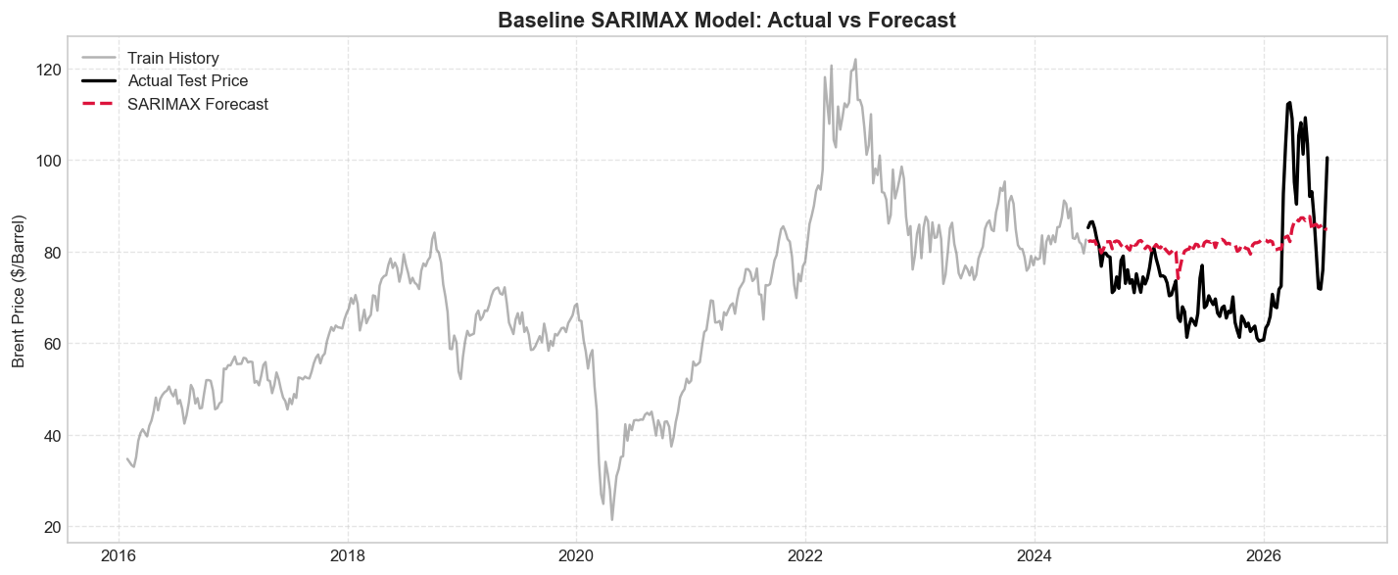
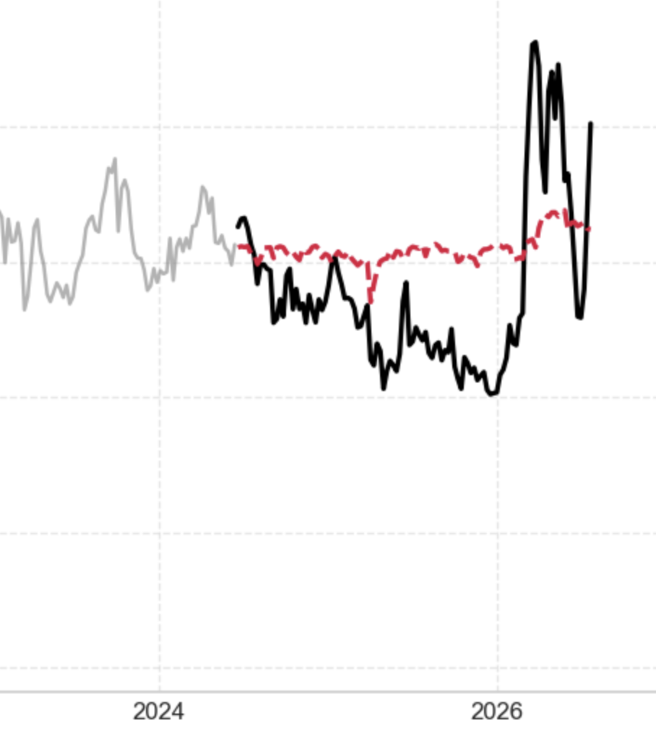
Baseline Failure & The Machine Learning Leap
LINEAR BASELINE FAILURE (SARIMAX)
Un-tuned SARIMAX(1,1,1) Error: MAE = $14.55, R² = -0.6357
AIC Grid-Search tuned to SARIMAX(0,1,0): MAE = $11.49
Flaw: Linear state-space models fail to adapt to severe geopolitical shocks without rolling updates.
THE MACHINE LEARNING BREAKTHROUGH
Error Reduction: Supervised ML models (Random Forest, XGBoost, LightGBM) reduced forecast error by ~76% down to the 3.40–3.58 range.
Variance Explained: R² jumped from negative to > 83%.
Log-space normalization (Brent_Log) stabilized extreme volatility spikes
Key Takeaway
PERFORMANCE LEAP
$3.50 MAE (Tree ML) vs. $11.29 MAE (Baseline)
+83.7% Variance Explained R²

Slide 5
Out-of-Sample Model Benchmarking
Performance evaluation table
Model Class | Model | MAE ($) | RMSE($) | R² score | MAPE (%) | Directional Acc. (%) | Durbin-Watson (closest to 2.0)
Econometric | SARIMAX Baseline | $14.55 | $15.98 | -0.6357 | 20.27% | 52.3% | 0.09
Linear ML | LASSO Regression | $3.28 | $5.16 | 0.8292 | 4.00% | 52.3% | 1.17
Tree Ensemble | Random Forest | $3.58 | $5.20 | 0.8267 | 4.52% | 45.0% | 1.43
Tree Ensemble | XGBoost (Champion) | $3.41 | $5.07 | 0.8350 | 4.29% | 51.4% | 1.36
Tree Ensemble | LightGBM | $3.40 | $4.85 | 0.8491 | 4.32% | 44.0% | 1.37
Deep Learning | LSTM Neural Network | $4.93 | $7.73 | 0.6172 | 5.95% | 52.3% | 0.49
Key Insights
Tree Model Dominance
Error Reduction: All tree-based models slashed the baseline error by ~76% (from $14.55 down to $3.40–$3.58).
High Variance Explained: Consistently captured over 82.6% of market volatility (R² > 0.826).
Scale Stability: Maintained a tight MAPE under 4.52% across the test horizon.
Econometric & Deep Learning Flaws
SARIMAX Drift: Durbin-Watson score of 0.09 indicates severe positive autocorrelation and compounding lag divergence.
LSTM Sample Constraint: Deep recurrent networks over-parameterized on ~550 weekly rows, failing to outperform simple tree ensembles (R² : 0.6172$).
Residual & Error Distribution
Symmetric Bell Curve: Residual errors show an unbiased distribution with a mean of -$0.60 and standard deviation of $5.06.
Reliable Risk Modelling: Narrow error tails confirm that predictions provide a sound base for institutional Value-at-Risk (VaR) calculations.

Slide 6
Champion Selection & Failure Analysis
Champion Justification (XGBoost)
Underperformance Diagnosis
Active Champion: XGBoost Regressor
Composite Score: 60.38
Directional Accuracy: 51.4%
RMSE: $5.07
R² : 0.8350
SARIMAX Baseline (Econometric Failure)
Rigid Stationarity: Cannot capture non-linear interactions between OPEC supply shocks and VIX volatility spikes.
Error Memory: Durbin-Watson score of 0.09 mathematically confirms compounding forecast divergence.
Trading Directional Movement Edge
Market Timing: Achieved 51.4% Directional Accuracy, outperforming LightGBM (44.0%).
Capital Protection: Essential for real-world trading to avoid buying into market tops or shorting market bottoms.
Out-of-Time Resilience: Maintained 45.9% directional accuracy even during the 2008 crash.
LSTM Neural Network (Sample Complexity Flaw)
Data Hunger: Deep recurrent networks typically require >=10,000 sequences. On ∼550 weekly rows, the model over-parameterized.
Regime Lag: Suffered from phase lag during rapid macro trend reversals (R² = 0.6172).
Model Stability & Risk Control
Smarter Learning Steps: Uses both the direction and curvature of errors to make smoother, more accurate price corrections.
Noise Filtering: Built-in penalty controls prevent the model from overreacting to single-week freak price spikes.
Risk Engine: Produces stable, narrow errors used to calculate the 1-Week 95% Value-at-Risk ($7.30/bbl).
LightGBM (Micro-Noise Overfitting)
Leaf-Wise Splitting: While raw RMSE was marginally lower ($4.85 vs $5.07), deep asymmetric trees chased weekly noise.
Directional Degradation: Caused Directional Accuracy to fall to 44.0% (Modern) and 36.5% (Historical).

Slide 7
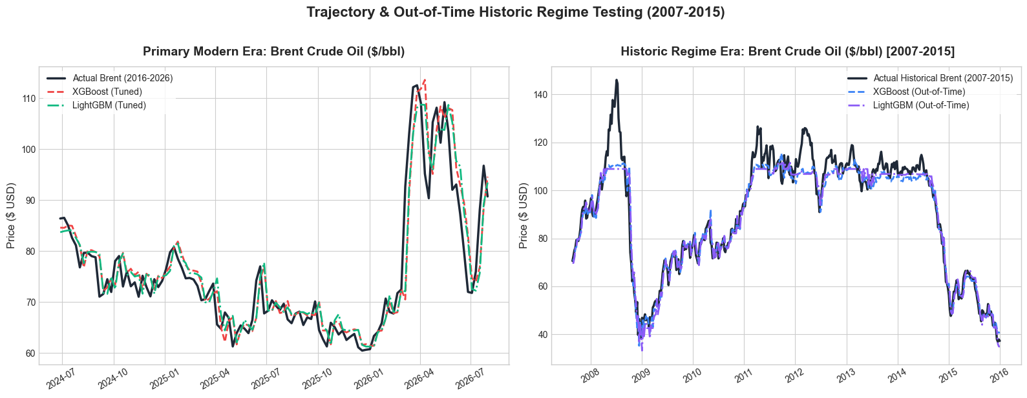
Out-of-Time Historic Regime Testing
Historical Testing Parameters
Observations: N = 437 weekly data points.
Market Regime: 2008 Global Financial Crisis (Peak > $140/bbl -> Trough -> $35/bbl).
Testing Goal: Evaluate out-of-time regime generalization without retraining parameters.
Generalization Fit
Structural Resilience: Neither XGBoost nor LightGBM diverged or broke during rapid price collapses.
Strong Fit: R² increased to 0.9281 (XGBoost) and 0.9244 (LightGBM) across wide historical price swings.
Error Stability
Scale-Independent Error: MAPE remained tightly bounded at 4.70% (XGBoost) and 4.81% (LightGBM).
Nominal Error Shift: Absolute errors rose slightly (MAE to $4.38) due to higher nominal base prices of $140, during that market cycle.
Feature Persistence
Dominant Predictor: Price_Lag_1 remained the dominant predictor across both eras.
Macro Confirmation: Consistent support from standardized macro signals (VIX_Z, OPEC_Z, USD_Z).
Key Insight: Models trained on modern data (2016–2026) maintained >92% variance explanation and stable <4.8% MAPE when evaluated on the 2008 Financial Crisis regime without retraining.

Slide 8
Limitations & Future Architectural Scope
Limitation
Improvement
Alternatives
Tree Extrapolation Ceiling: Tree-based models cannot predict values higher/lower than historical training extrema.
OPEC Quota Step-Artifacts: Forward-filling monthly production quota data introduces artificial zero-variance plateaus into weekly features.
Static Validation: The fixed chronological 80/20 split done to the models does not adapt dynamically to market regime flips.
Stationary Returns Target: Train on log-differenced returns instead of nominal price levels to eliminate boundary ceilings.
High-Frequency Logistics: Ingest real-time daily satellite tanker tracking flows (e.g., Kpler, Vortexa) instead of lagged monthly OPEC quotas.
Expanding Window Walk-Forward CV: Re-train continuously across rolling windows to mirror live production trading.
Temporal Fusion Transformers (TFT): Advanced AI networks that dynamically highlight which economic drivers (USD, VIX, OPEC) matter most across future weeks.
Markov-Switching Hybrids: Smart algorithms that recognize when the market enters panic mode and route predictions to a dedicated crisis model.
Stacking Meta-Learner: Combine XGBoost’s non-linear tree splits with LASSO's shrinkage and ARIMA's linear residual handling.

Slide 9
Dashboard Demonstration

Slide 10
Thank you
Q&A

